Slide 1
Setting up a Home Work Environment for PHP/MySQL
Systems Software & Networks
Patrick Donohue

Slide 2
Topics
Downloading Apache
Downloading PHP
Downloading MySQL
Downloading and testingWAMP
Test MySQL and Download a free PHP editor

Slide 3
Downloading Apache
Many organizations have Apache downloads
To go to the main Apache site type
http://httpd.apache.org/download.cgi#apache24
Scroll down to the first Win32 binary link
(without crypto)
Follow the installation instructions

Slide 4
Downloading PHP
To download PHP:
http://php.net/downloads.php
Scroll down to Windows binaries and source
Install the first ZIP file
Follow any installation instructions.
If PHP does not work, it may be because the PHP.INI file is not in c:\windows.

Slide 5
Downloading MySQL
Download from:
http://www.mysql.com/downloads/mysql/
Download Community Server version
64 or 32 bit
Again follow instructions

Slide 6
Downloading WAMP
XAMPP (Generic)
MAMP (Mac)
WAMP (Windows) consists of
Apache
PHP
MySQL
PhpMyadmin
Other utilities
Download from:
www.wampserver.com

Slide 7
Setting up WAMP
May require portable Microsoft Visual C++ redistributable package
Click on link and install (WAMP needs C++ to operate)
Install package and follow instructions

Slide 8

Setting up WAMP
When installed you will see:

Slide 9
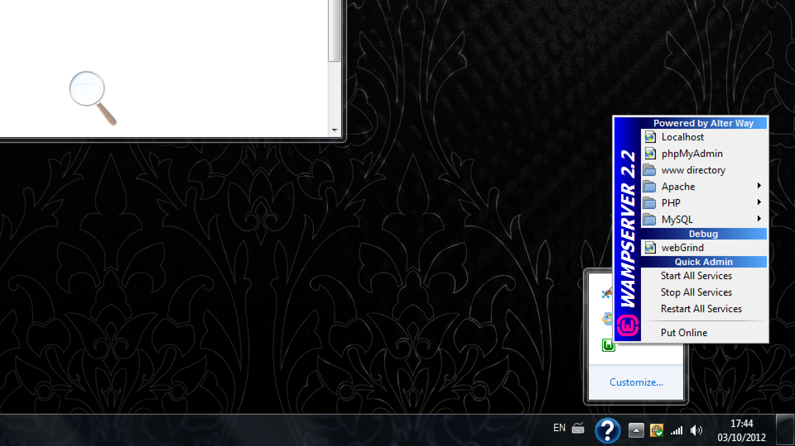
Setting up WAMP
Zooming in:

Slide 10
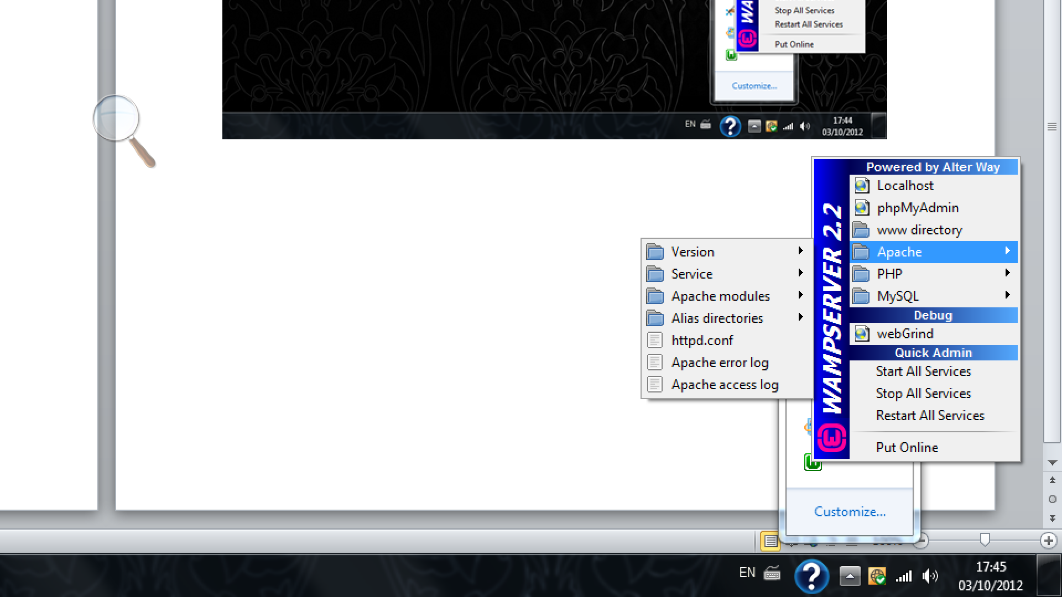
Setting up WAMP
Zooming in (Apache):

Slide 11
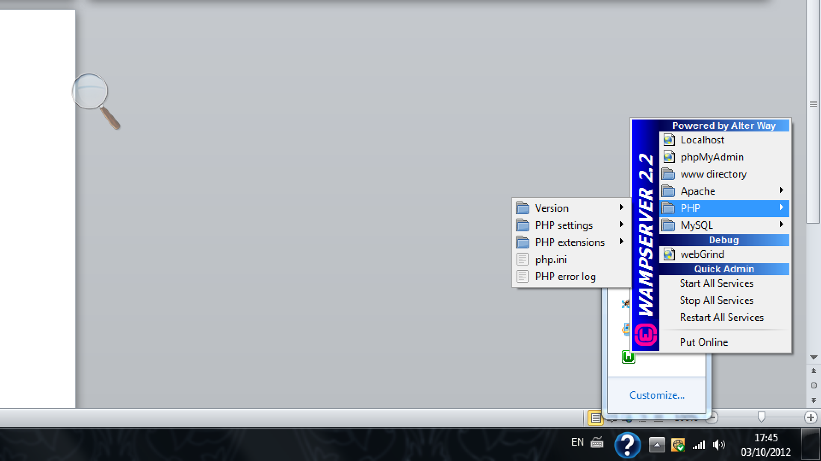
Setting up WAMP
Zooming in (PHP):

Slide 12
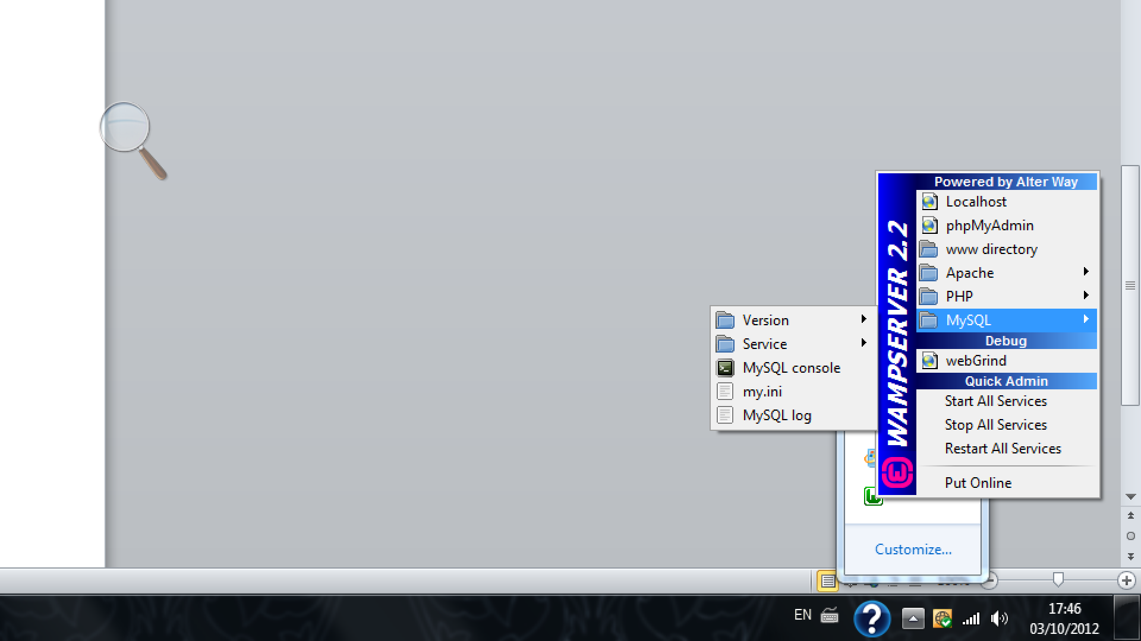
Setting up WAMP
Zooming in (MySQL):

Slide 13
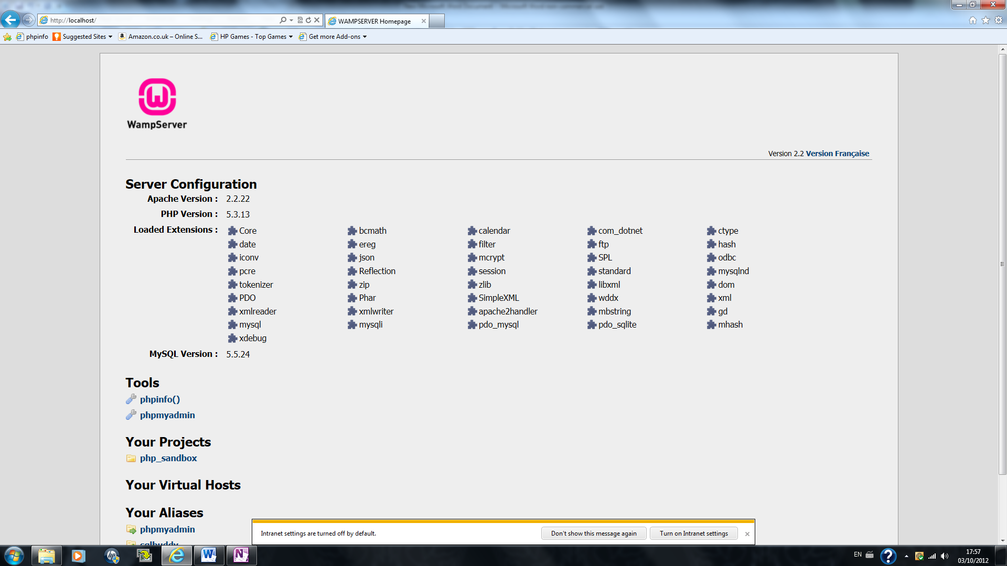
Testing
Type http://localhost in browser, you should get something like:

Slide 14
Some Detail
The default root directory for WAMP is C:\WAMP\www
This is the home folder (directory)
Create a folder under this directory for testing, e.g., C:\WAMP\www\mySandbox
For convenience create a shortcut to your desktop
To access a page in the sandbox, type http://localhost/mySandbox/Hello.html
Or: http://localhost/mySandbox/Hello.php if its a Php file.

Slide 15
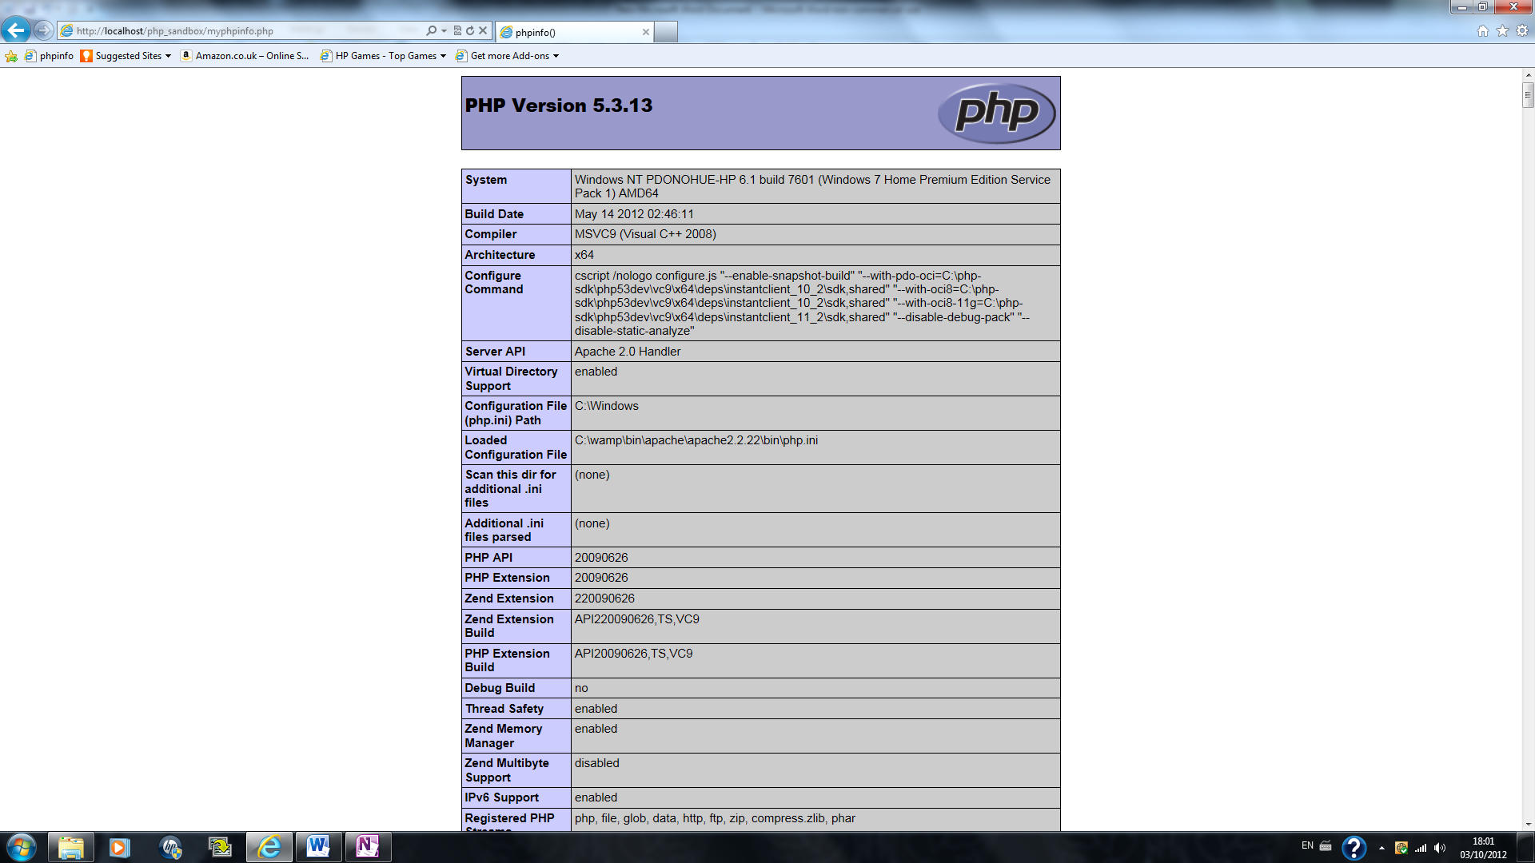
To test PHP
Create a file called myphpinfo.php which includes:
<?php phpinfo(); ?>
If PHP is working, you should get:

Slide 16
Test MySQL and Download a PHP editor
Click on MySQl console link
If mysql prompt is displayed, MySQL is working
Php editor
Download a free Php editor for example Komodo Edit
Go to www.activestate.com
You are now ready to go!

